Slide 1
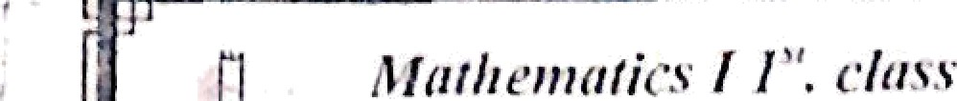

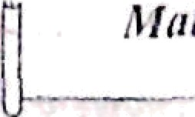

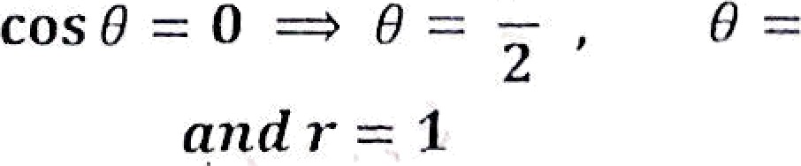
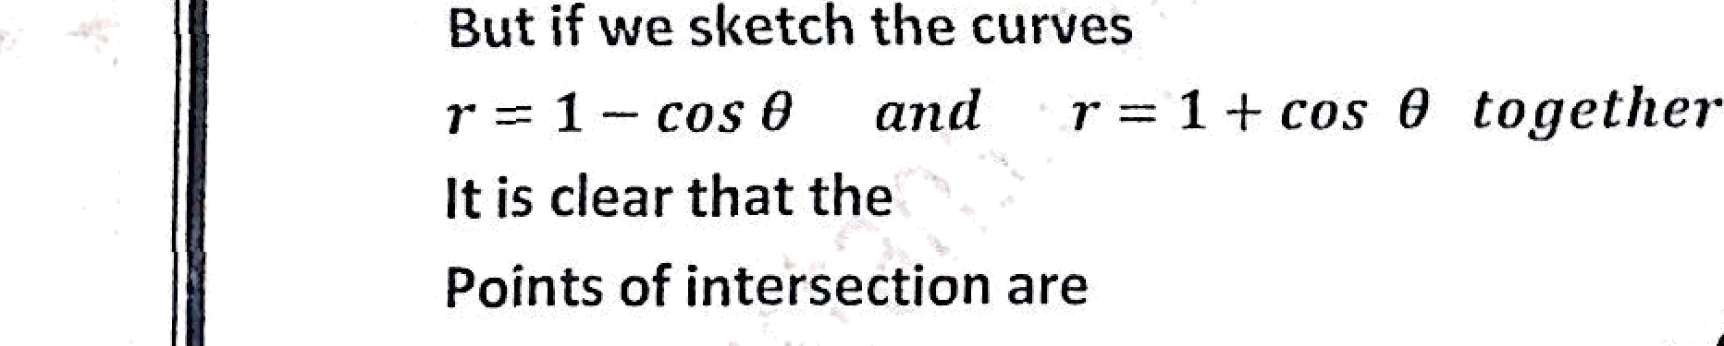
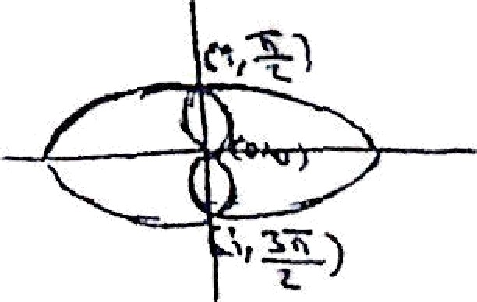

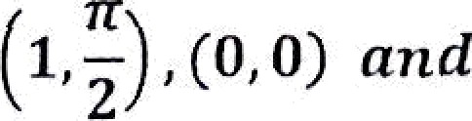

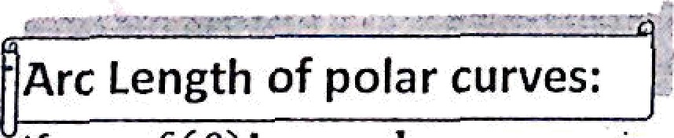
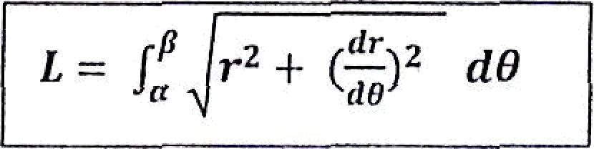
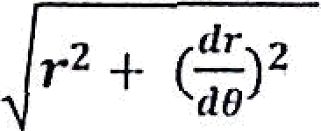
.*.
.* w/3
{ 16 com 8
8 [ (1 + com
)] — 10} dP
+ 2 sin 20 — 10 s ] = Io : 4n
Note . ’l’o find the point of’ intersection be ivccii two ciii’vcs iii polar Ago . it is good idea to image a sketch of the curves to ilcl fmiNc lion many point of inter section there shonl‹J I› .
For example the curves
r = 1 — cos 8 rind r = 1 4 cos 8
1 — cos 8 — 1 + cos 8
2 cos 8 = 0
2
•• the points of the ixte Section are (1,d) ,
1,' )
(i, ^{3x} )
- Arc Length of polar curves:
It r = f(8)is a polar curve iuch that„5’(8) is continuos for
!'
then the arc length defined by
121

Slide 2
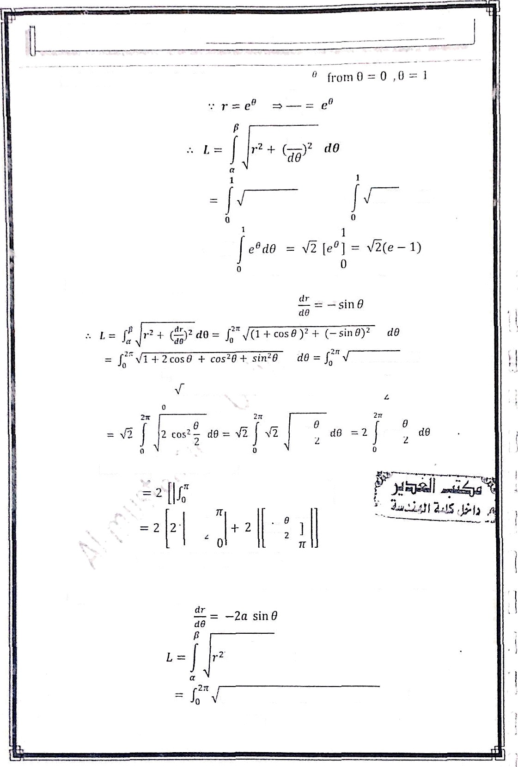


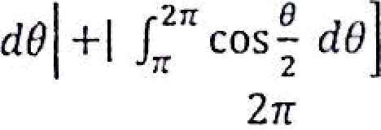

E x/ Find the arc length of the polar curve r = e
dT
dB
dY
e²* -F e!*
‹t0 -
2e²*
d8
Ex / find the arc length of the cardioid
i•
1 -F Cos 0
2 -I- 2 cos 8 d8
=
1 + cms 8
d8 but 1 -L cos = 2 cus* -
COS'
£OSi
but
8
COS —
COS -
sin -
= 4 1 — 0J -F 4 ]0 — IQ = 8
ex/ Find the arc length of the curve ( entire circle
r = 2n cos 8)
dr
d8
'd8
(2n cos 8 ) + (—2n sin 8)° d8
122

Slide 3

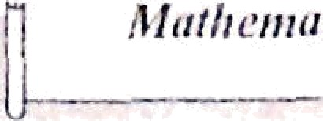




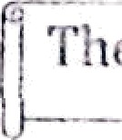
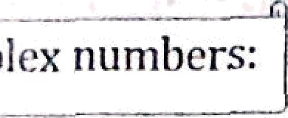

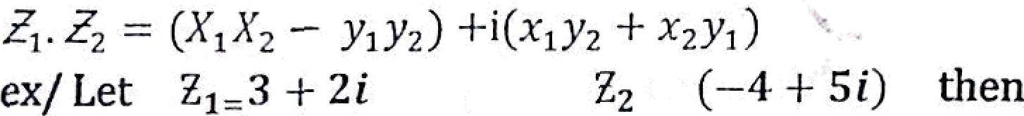

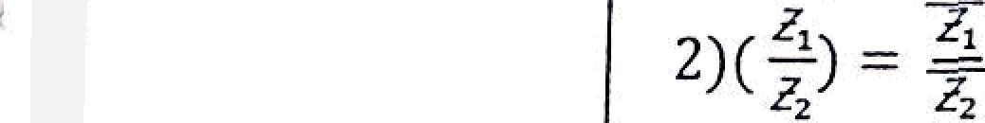
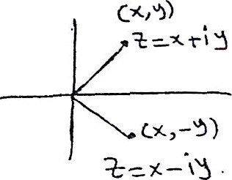
/ 2a osc0 + sha" f7
dfJ ?u /, " d0
‘2 a 0
4 rt if
0
The CO_{• F} ex numbers:
the complex number 25= a -F iy , i
where x = R (I) and y = lm( >)
1) addiéon & s ubtraction
L4t f _{t} = /
+ ‹ y‹ . 4 — ›2 + ‹y›
then + r =*› — (<› r < ) + i(› + y2)
2) multiplication two complex numbers
1 + 2 1 ' + (
1 ' 2
₎] + i[ (2) -F 5) —1 -F 7i
3 — (—4)) -1- i[ 2 — 5] = 7 — 3i
225, = 2(3 + 2 i) = 6 -F 4i
Z . Z -= (3 -F 2i) -I-i(—4 + 5i)
= [(3)(—4) — (2)(5)] + i [ (3)(5) + (2)(—4)]
= [—l2 — 10] -I- i[lS — 8] = —22 -I- 7i
the conjugate of a complex number E’= x + iy
is the complex number x — iy
Properties
1) 35a?; +
= + + +
3)5 fy x' + y'
4) Z+ Z —— 2x = 2 Re( E)
123

Slide 4
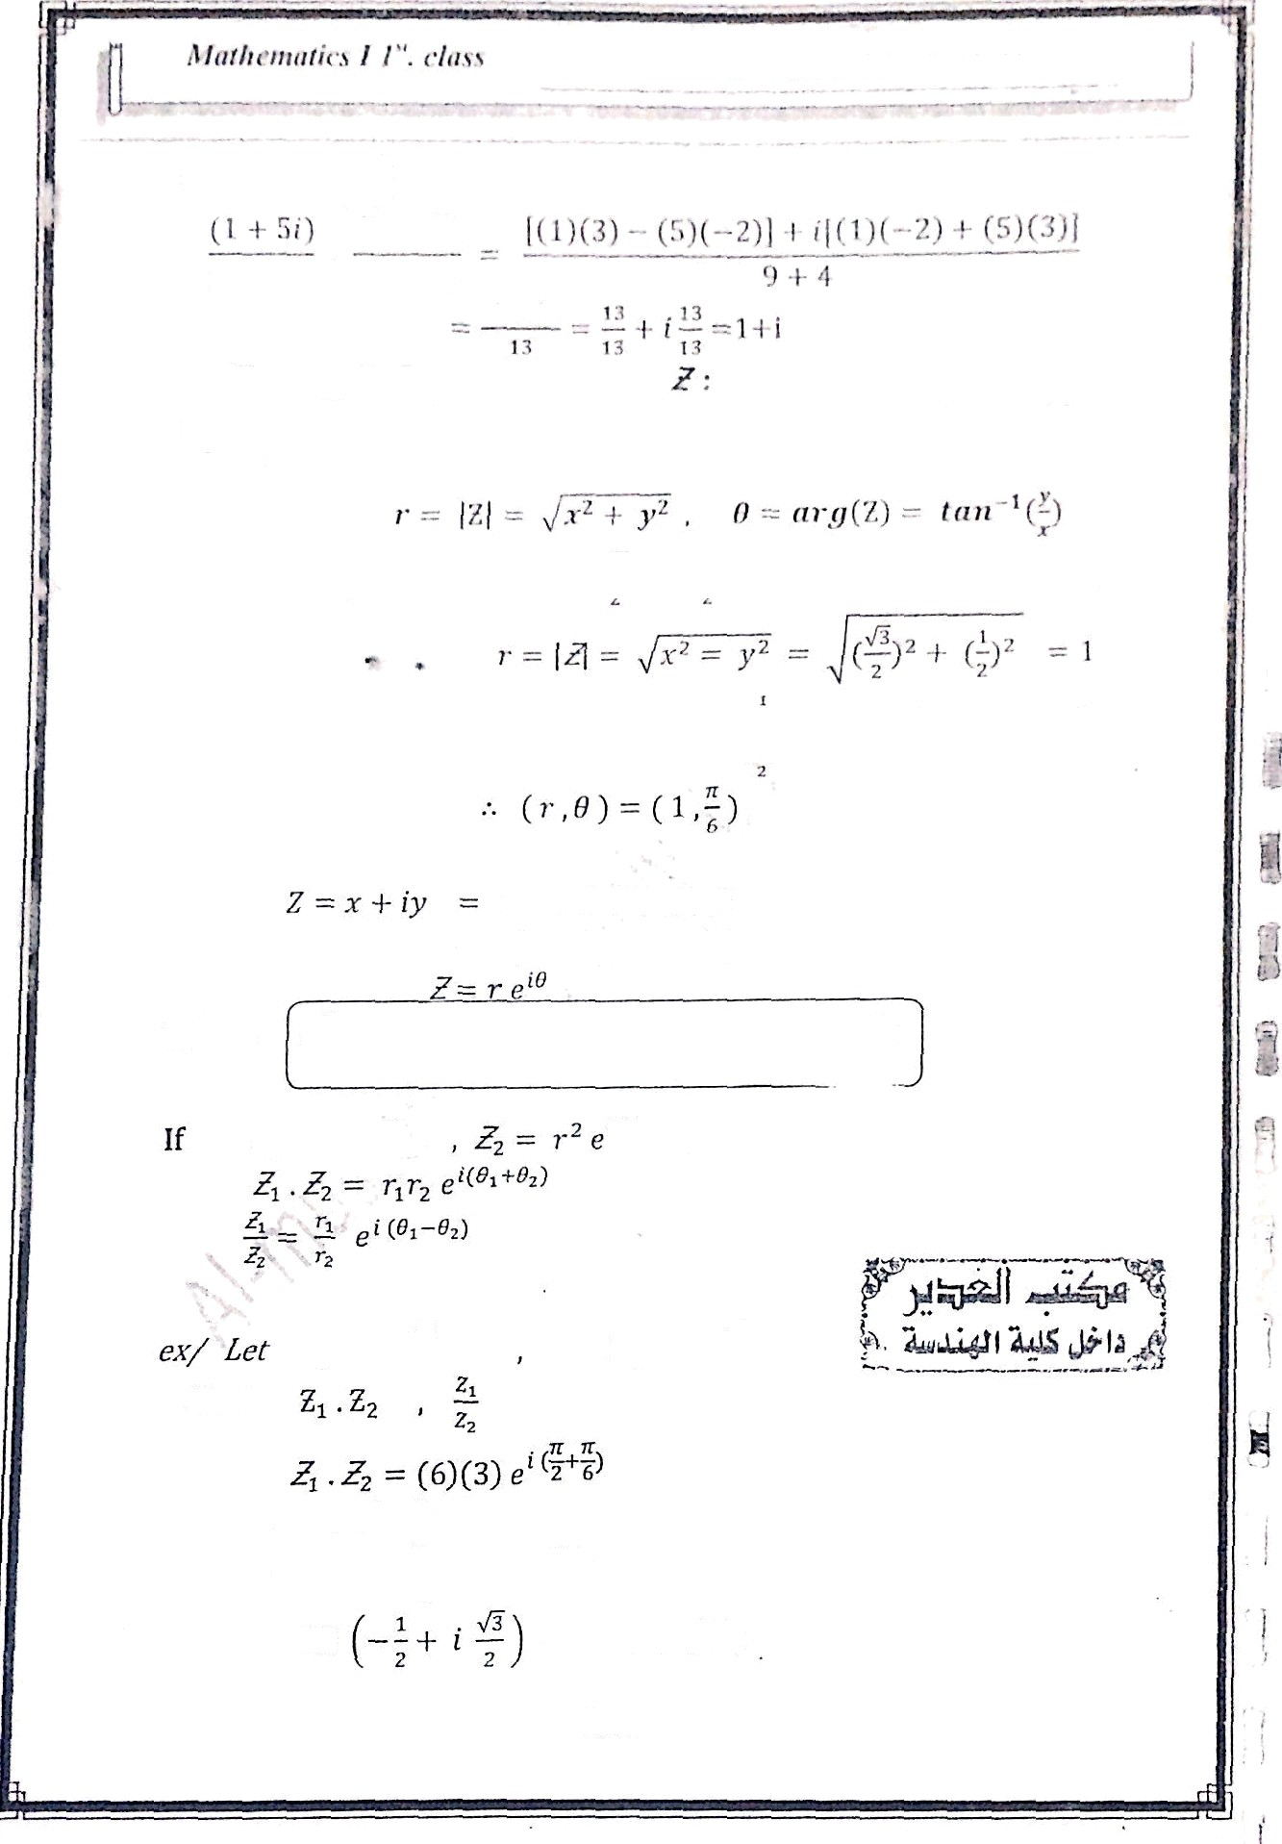









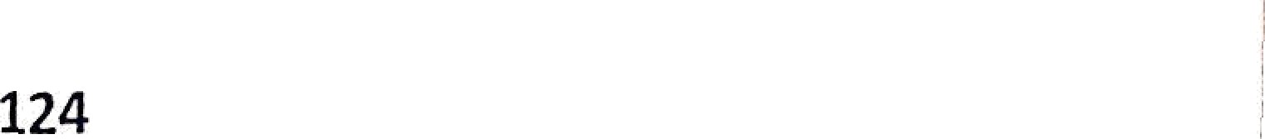
Axel. I’r”‹›l. . thl›it ) '• A!-4lii****ti*rî’
ex/ Find " '
- •
The magnihide and argument of
Each complex nuniber can bc written In polar ooo . as
-- (r , li )
ex/ the complex number - + i y can be written In polar form
8 tan°'
-— tan* ^{l}
r cos # + ir sin 8
- r ( cos 8 i sin 8 )
e” cos 8 + i sin 8 Enter forniula
Where
2
then
.n
Z, - 6 e'“
t-
Fi“nd
-18
_{e} 2l /3
- 18 (cos ²
3
. . 2K
f sln
3
,
— 18
9 + 9 •7(Ñi

Slide 5
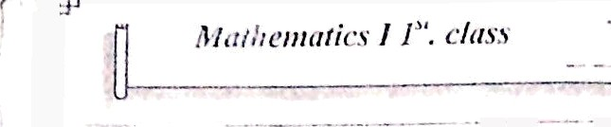




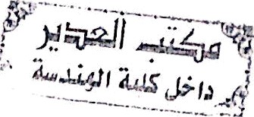

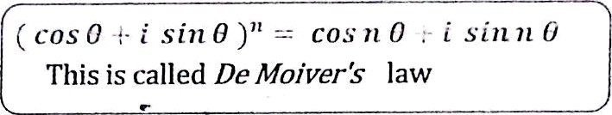

= 2 c' " '
tOS- d- 1 sin J)
3
= 1 +
í
Note :
( e")” c'"
( cos 0 !- , s in 8 )" — cos ii 0 : i s in ii G This is called De 3foizer’s law
Ex y’ Use De Molver’s lamto End cos 4 B v ii = 4
( cos 8 -l- i sin 8 )* = cos 4 8 + i sin 4‘ 8
sin 4 8
cos’ * ^{T C’}
cos' 8 ( i sin 8) + Cy’ cos² 8 ( i sin 8 )^ + C/° cos 8 ( i Sin 8 )" + C,* ( i Sin 8 )’
—— cos 4B + t sin 48
cos’ 8 + 4 cos’ 8 [ i sin 8) — 6 cos’ 8 sin’ 8 + 4 cos 8 i sin' 0) + sin’ 8
= cos 4 8 + i sin 4 8
cos 4 8 = cos’ B — 6 cos² 8 sin' 8 + sin’ 8
sin 4 8 = .4 cos' 8 sin B -l- 4 cos B sin' B
and
(Roots of complex numbers
—— r’*v e'
"” ²' ^{')}
k —— 0.1 , 2, ... , q — 1
'" “
e
= r '« cos
( 8 + 2kn) -I- f sist ( 8 + 2 k›r))
ext' End the zoots al 8 |  |  |  |  | = ( —8 i )^{I}'
J= z + iy = 0 — 8 |  |  |  | i. | x = 0 , y = |  | —8
r | = | {J — | 2 ₊ | y |  | 0 + ( | 8) | = 8
 |  | 8 = | tan*¹ | — | tan | —8 0 | n 2 | 3s 2
!* -— r '°
cos (8 + 2kn) + i sin' ( 8 + 2kc)) k -- 0,1,2,3
125

Slide 6
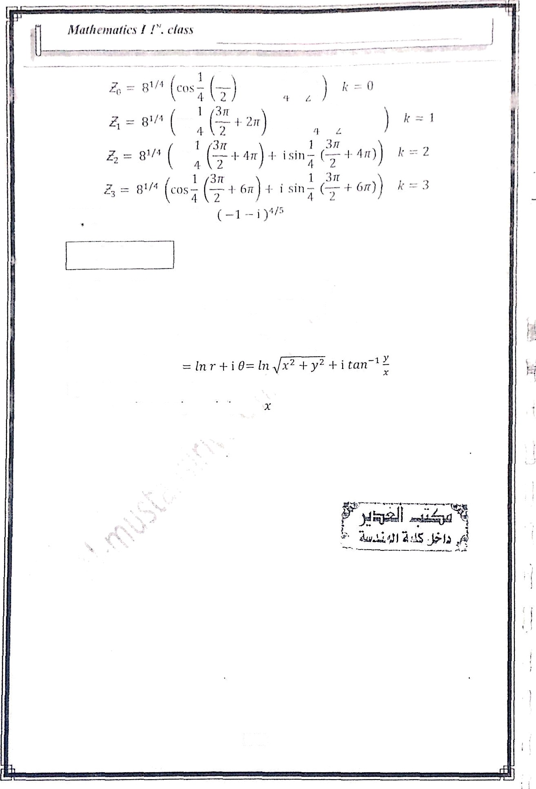
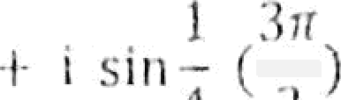

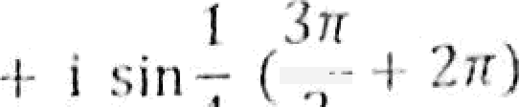

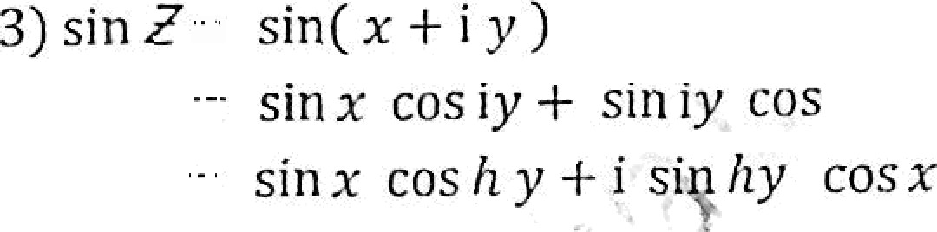
úx
H.W¢ Find the root of
Complex functions
126

